Slide 1
Dapr Distributed Application Runtime
DevApps Meetup - Saison 04 Episode 04
Laurent Kempé -   @laurentkempe 19 May 2021

Slide 2
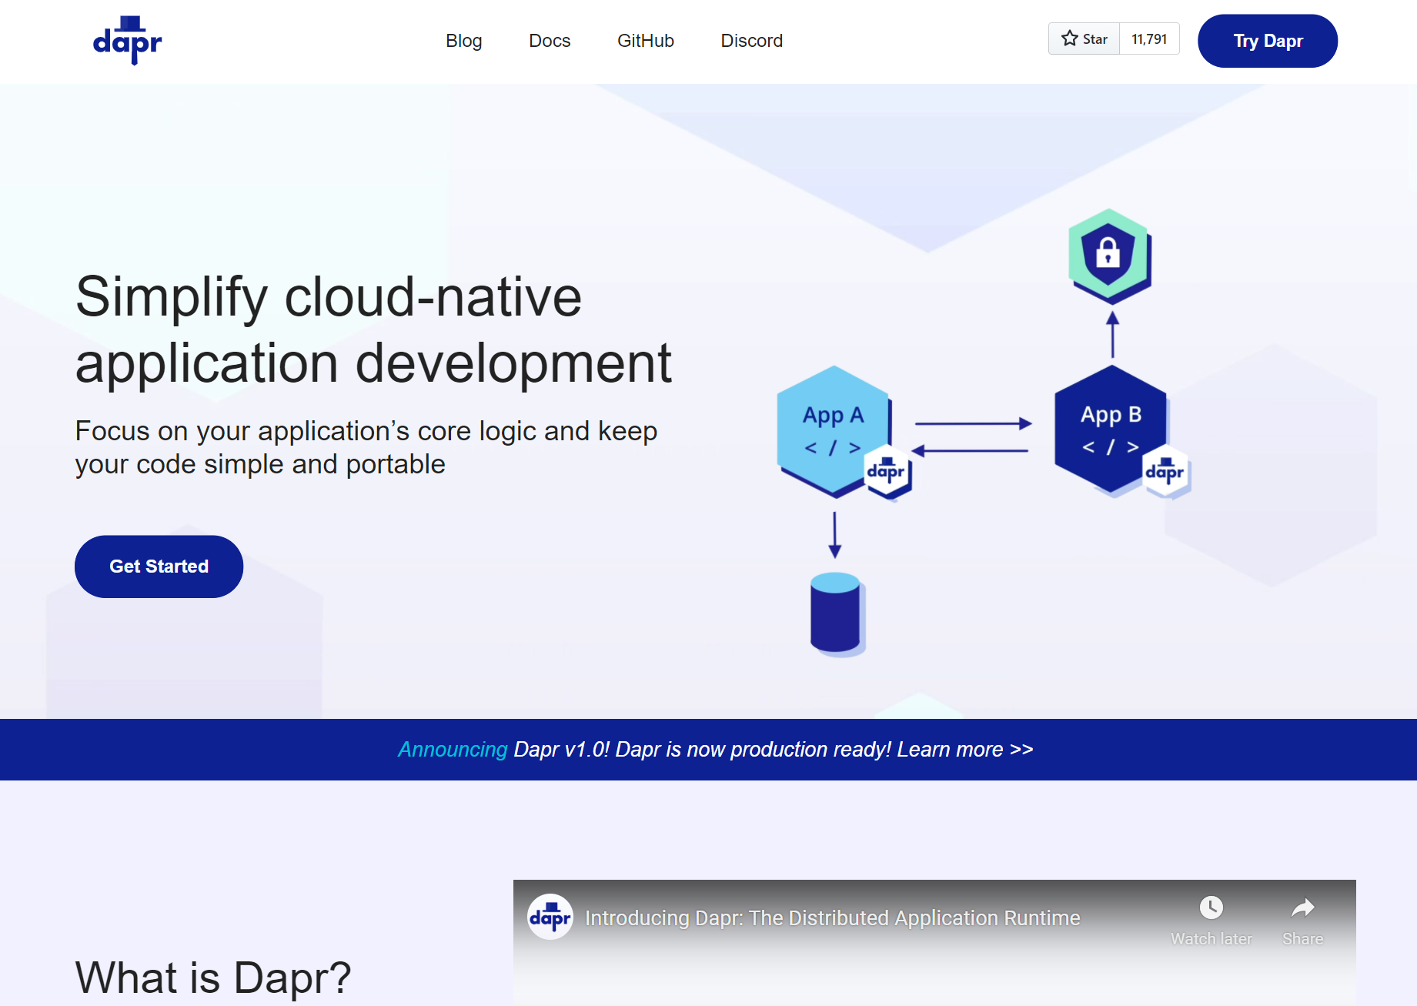
Distributed Application Runtime
Portable, event-driven, runtime for building distributed applications across cloud and edge
dapr.io

Slide 3
Dapr Goals
Best-practices building blocks
Any language or framework
Consistent, portable, open APIs
Adopt standards
Extensible and pluggable components
Platform agnostic cloud + edge
Community driven, vendor neutral

Slide 4
Microservice building blocks
HTTP API
gRPC API
Service-to-service invocation
State management
Publish and subscribe
Resource bindings and triggers
Actors
Observability
Secrets
Extensible

Slide 5
Any language and framework
Standard APIs accessed over http/gRPC protocols from user service code
Runs as local “side car library” dynamically loaded at runtime for each service
Application code
Microservices written in
Any code or framework…
HTTP API
gRPC API
Service-to-service invocation
State management
Publish and subscribe
Resource bindings and triggers
Actors
Observability
Secrets
Extensible

Slide 6
Any cloud or edge infrastructure
Application code
Microservices written in
Any code or framework…
HTTP API
gRPC API
Service-to-service invocation
State management
Publish and subscribe
Resource bindings and triggers
Actors
Observability
Secrets
Extensible
Hosting infrastructure
Azure Arc
On-Premises

Slide 7
Sidecar model
Application
Dapr sidecar
My App
Dapr API
HTTP/gRPC
POST http://localhost:3500/v1.0/invoke/cart/method/neworder
GET http://localhost:3500/v1.0/state/inventory/item67
POST http://localhost:3500/v1.0/publish/shipping/orders
GET http://localhost:3500/v1.0/secrets/keyvault/password

Slide 8
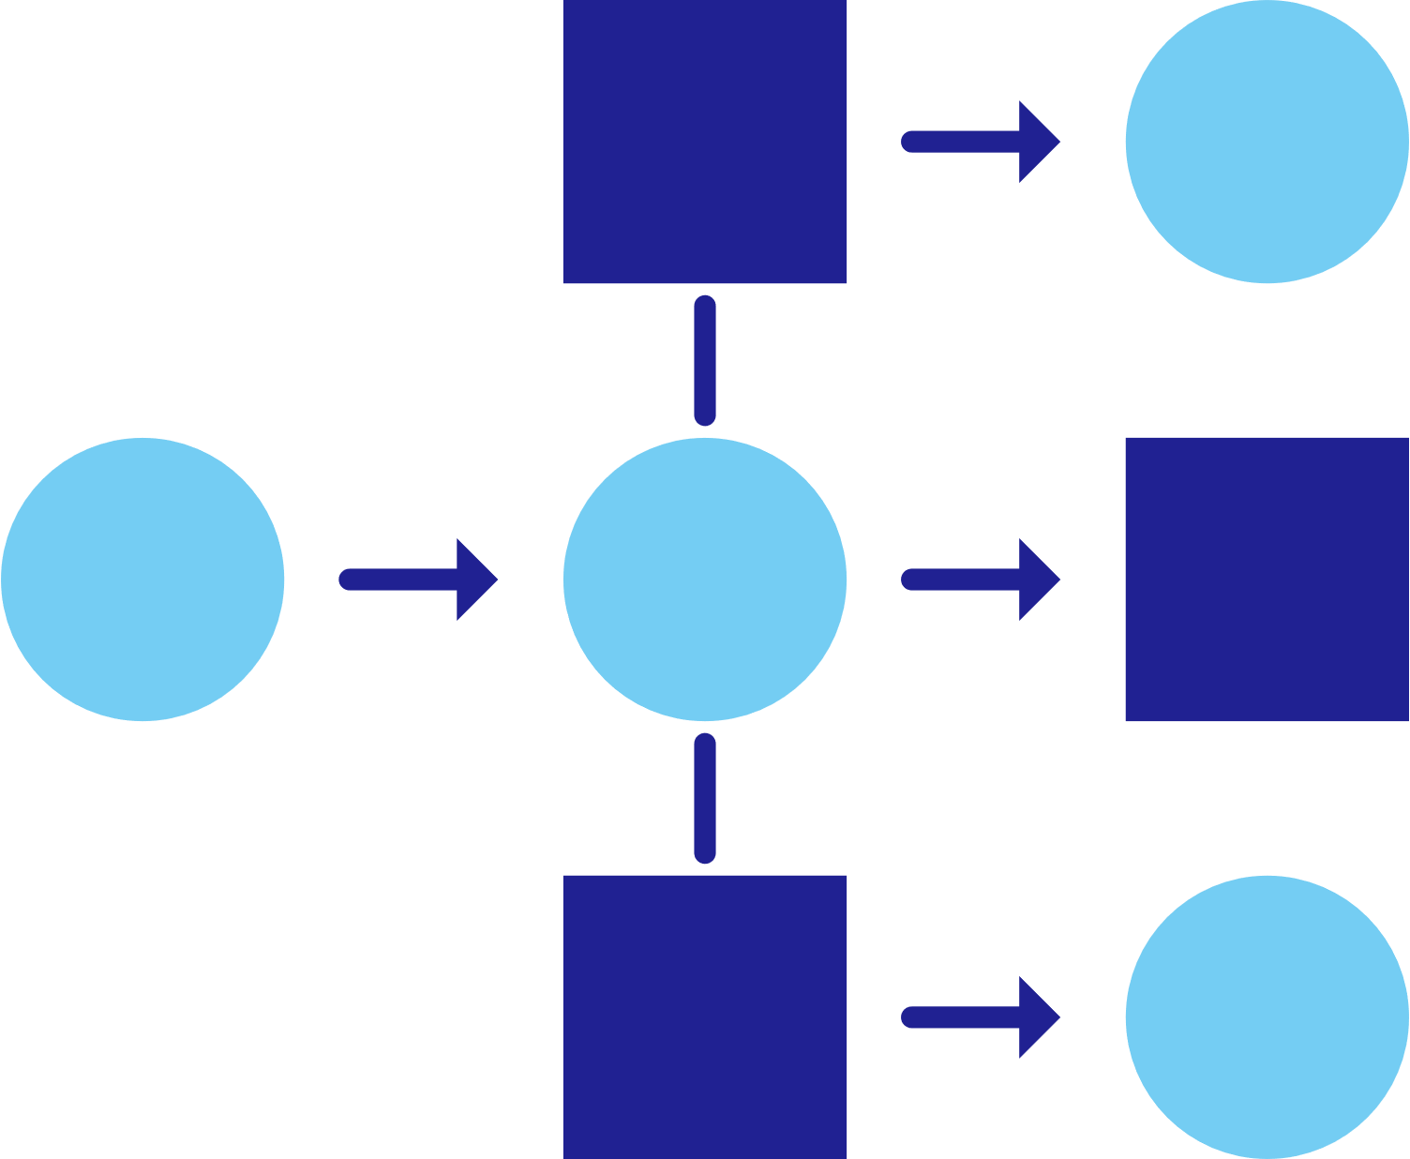
Dapr applications
Service A
State
Management
Service
Invocation
My App
PubSub
Messaging
Bindings
& Triggers
Secret
Management
Virtual
Actors
Service B
Observability

Slide 9
Dapr components
State
Stores
AWS
DynamoDB
Azure
CosmosDB
Firebase
Redis
Cassandra
PubSub
Brokers
AWS
SQS
Azure
Service Bus
GCP
Pub/Sub
Redis
RabbitMQ
My App
Bindings
& Triggers
AWS
S3
Azure
Storage
GCP
Storage
Twilio
Kafka
Swappable YAML files with
resource connection details
Over 70 components available
Create components for your resource at: github.com/dapr/components-contrib
Secret
Stores
AWS
Secrets Manager
Azure
KeyVault
GCP
Secret Manager
HashiCorp
Vault
Kubernetes
Secret
Observability
Prometheus
AppInsights
Zipkin
Jaeger

Slide 10
Dapr building blocks
Service-to- service invocation
State management
Publish and subscribe
Bindings
(input/output)
Actors
Observability
Secrets
Perform direct, secure, service-to-service method calls
Create long running, stateless and stateful services
Secure, scalable messaging between services
Trigger code through events from a large array of inputs
Input and output bindings to external resources including databases and queues
Encapsulate code and data in reusable actor objects as a common microservices design pattern
See and measure the message calls across components and networked services
Securely access secrets from your application

Slide 11
Service invocation
mDNS
Multicast DNS component for service discovery
My App
Service A
mTLS encryption
POST
http://localhost:3500/v1.0/invoke/servicea/method/neworder
POST
http://10.0.0.2:8000/neworder
{"data":"Hello World"}
{"data":"Hello World"}

Slide 12
State management
Redis Cache
My App
key | value
myApp-weapon | "DeathStar"
POST
http://localhost:3500/v1.0/state/corpdb
[{
"key": "weapon",
"value": "DeathStar"
}]

Slide 13
State management
Redis Cache
Azure CosmosDB
My App
key | value
myApp-weapon | "DeathStar"
key | value
myApp-weapon | "DeathStar"
GET
http://localhost:3500/v1.0/state/corpdb/planet
"DeathStar"

Slide 14
State management
Azure CosmosDB
Redis Cache
My App
key | value
myApp-weapon | "DeathStar"
key | value
myApp-weapon | "DeathStar"
GET
http://localhost:3500/v1.0/state/corpdb/planet
"DeathStar"

Slide 15
Dapr state API
corpdb-redis.yaml
apiVersion: dapr.io/v1alpha1
kind: Component
metadata:
name: corpdb
spec:
type: state.redis
version: v1
metadata:
- name: redisHost
value: redis-master.default.svc.cluster.local:6379
- name: redisPassword
secretKeyRef:
name: redis-secret
key: redis-password
Save state
POST /v1.0/state/corpdb
Retrieve state
GET /v1.0/state/corpdb/mystate
Delete state
DELETE /v1.0/state/corpdb/mystate
Get bulk state
POST /v1.0/state/corpdb/bulk
Submit multiple state transactions
POST /v1.0/state/corpdb/transaction

Slide 16
Dapr state API
corpdb-cosmosdb.yaml
apiVersion: dapr.io/v1alpha1
kind: Component
metadata:
name: corpdb
spec:
type: state.azure.cosmosdb
version: v1
metadata:
- name: url
value: corpdb.documents.azure.com
- name: masterKey
secretKeyRef:
name: master-key
key: cosmos-key
- name: database
value: orders
- name: collection
value: processed
Save state
POST /v1.0/state/corpdb
Retrieve state
GET /v1.0/state/corpdb/mystate
Delete state
DELETE /v1.0/state/corpdb/mystate
Get bulk state
POST /v1.0/state/corpdb/bulk
Submit multiple state transactions
POST /v1.0/state/corpdb/transaction

Slide 17
Publish and subscribe
Service A
My App
Redis
Cache
Service B
POST
http://localhost:3500/v1.0/publish/orders/processed
POST
http://10.0.0.2:8000/orders
http://10.0.0.4:8000/factory/orders
{"data":"Hello World"}
{"data":"Hello World"}

Slide 18
Dapr pub/sub API
orders.yaml
apiVersion: dapr.io/v1alpha1
kind: Component
metadata:
name: orders
spec:
type: pubsub.redis
metadata:
- name: redisHost
value: leader.redis.svc.cluster.local:6379
- name: redisPassword
secretKeyRef:
name: redis-secret
key: password
- name: allowedTopics
value: "processed,audit"
App-to-sidecar
Publish a message
POST /v1.0/publish/orders/processed
Sidecar-to-app
Get app subscriptions
GET /dapr/subscribe
Publish to app
POST /order-processing

Slide 19
Input triggers
Twitter
My App
POST
http://10.0.0.2:8000/newtweet
{"data":“📢 We are excited to announce the …"}

Slide 20
Output bindings
My App
Twilio
POST
http://localhost:3500/v1.0/bindings/twilio
Hello World
{"data":"Hello World"}

Slide 21
Dapr bindings API
twitter.yaml
apiVersion: dapr.io/v1alpha1
kind: Component
metadata:
name: twitter
spec:
type: bindings.twitter
version: v1
metadata:
- name: consumerKey
secretKeyRef:
name: twitter-secret
key: consumerKeys
- name: consumerSecret
secretKeyRef:
name: twitter-secret
key: consumerSecret
- name: accessToken
secretKeyRef:
name: twitter-secret
key: accessToken
- name: accessSecret
secretKeyRef:
name: twitter-secret
key: accessSecret
App-to-sidecar
Invoke an output binding
POST/PUT /v1.0/bindings/twitter
Sidecar-to-app
Trigger an app
OPTIONS/POST /new-tweet

Slide 22
Secrets
My App
HahsiCorp Vault
key | value
mysecret | "supersecret"
GET
http://localhost:3500/v1.0/secrets/vault/mysecret
"supersecret"

Slide 23
Dapr secrets API
vault.yaml
apiVersion: dapr.io/v1alpha1
kind: Component
metadata:
name: vault
spec:
type: secretstores.hashicorp.vault
metadata:
- name: vaultAddr
value: https://127.0.0.1:8200
- name: caCert
value: "ca_cert"
- name: caPath
value: "/certs/cert.pem"
- name: caPem
value: "/certs/ca.pem”
App-to-sidecar
Retrieve a secret
GET /v1.0/secrets/vault/mysecret
Retrieve secrets in bulk
GET /v1.0/secrets/vault/bulk

Slide 24
Observability
Service A
Twitter
My App
Redis
Cache
Service B
OpenTelemetry collector
Logging &
tracing extensions

Slide 25
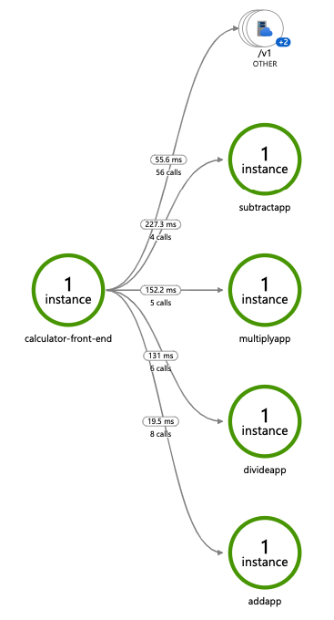
Distributed tracing
Emit tracing data from calls to/from Dapr sidecars and system services for easy application-level instrumentation
Dapr distributed tracing features:
Built-in Zipkin collection and viewer
Configurable sampling rates

Slide 26
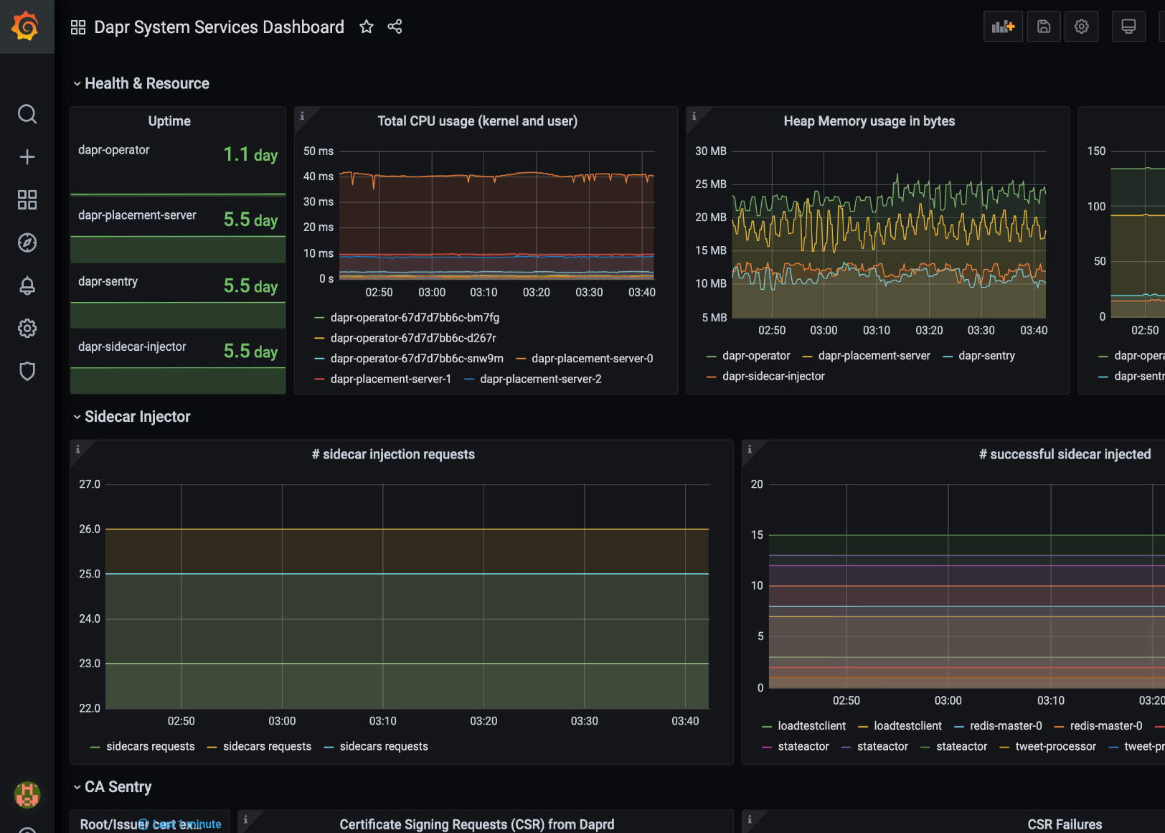
Metrics
Built-in monitoring capabilities to understand the behavior of the Dapr sidecar and system services
Dapr Metrics features:
Call latency
CPU/memory usage
Error rates
Sidecar injection failures
System health

Slide 27
Dapr hosting environments
Get started with dapr init
Easy setup with Docker images
Sets up placement, Zipkin, Redis
slim-init available without Docker
Run any application with Dapr sidecar using dapr run
Get started with dapr init -k
Fully managed Dapr control plane
Deploys dashboard, placement, operator, sentry, and injector pods
Automatically inject Dapr sidecar into all annotated pods
Upgrade with dapr upgrade or Helm
Self-hosted

Slide 28
Dapr in self-hosted Docker mode
Dapr Components
dapr run myapp
State Stores
Launch application
Launch sidecar process
Set env variables
Actor
placement
PubSub
Brokers
Placement
Create mapping table of actor instances to pods
My App
Use components
Bindings
& Triggers
Zipkin
tracing
Zipkin
Send distributed tracing
Secret Stores
Redis
state store
Redis
Save and retrieve state
Publish and subscribe to messages
Local dev machine or virtual machine
Observability

Slide 29
Dapr on Kubernetes
Operator
Deploys and manages Dapr
Dapr Components
Pod
Pod
Pod
Pod
State Stores
Actor partition placement
Dapr
runtime
injector
Cert authority
and identity
Update component
changes
Placement
Injector
Sentry
Operator
Pub/Sub
Brokers
Create mapping table of actor instances to pods
Inject Dapr sidecar into annotated pods
Inject env variables
Manage mTLS between services
Assign spiffe identity
Manage component updates
Manage Kubernetes
service endpoints
Pod
Bindings
& Triggers
My App
Secret Stores
Readiness and Liveness probe on healthz API to determine Dapr health state
Kubelet
Use components
Observability
Any cloud or edge infrastructure

Slide 30
References
Dapr.io Dapr on Github
Dapr on discord
Dapr for .NET Developers 📘
Learning Dapr - Building Distributed Cloud Native Applications 📘
Dapr SDK for .NET 👩🏼‍💻
eShopOnDapr, .NET distributed application 👩🏼‍💻
My Dapr playground 👩🏼‍💻
My Dapr blog posts

Slide 31
Thank You! 🚀 Laurent Kempé https://laurentkempe.com/  @laurentkempe  @laurentkempe

